Slide 1

VECTO 2.2 10.09.2015
Release Notes

Slide 2
VECTO 2.2
Main updates
Moved gear-specific Full Load Curves to Gearbox File
Combined Drag Coefficient * Cross Sectional Area in one input parameter
Removed WHTC Correction Factor Calculation.
Added link to CITnet / JIRA

Slide 3
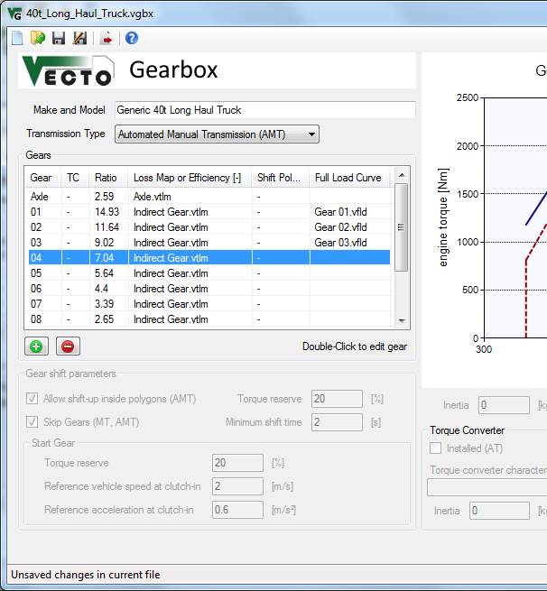
Gear-specific Full Load Curves
Gear-specific Full Load Curves are now defined in the Gearbox File
Used for torque limiting
Basis for generic shift polygons*
If no file is defined, the engine full load curve is used.
* The torque curve used for generation of shift polygons is the minimum curve of engine full load curve and gear box "full load" curve

Slide 4
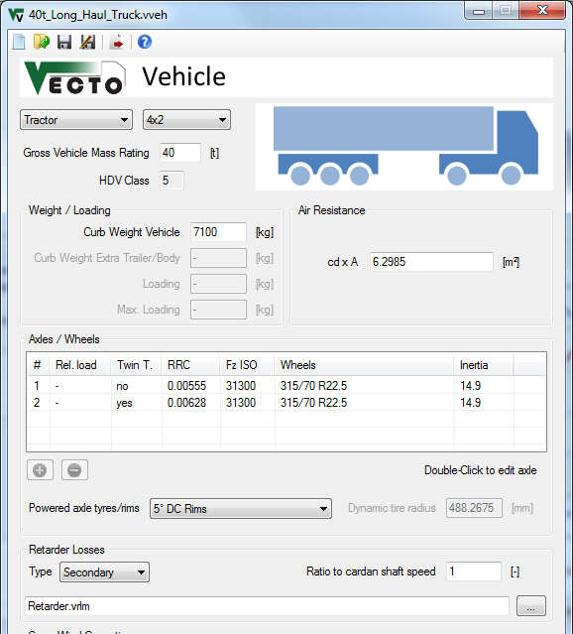
Combined Drag Coefficient * Cross Sectional Area
VECTO now uses the c_{d}xA product instead of separating the two parameters
VECTO CSE exports the c_{d}xA product, which can now be inserted into VECTO without separating.
Old .vveh files are compatible.

Slide 5
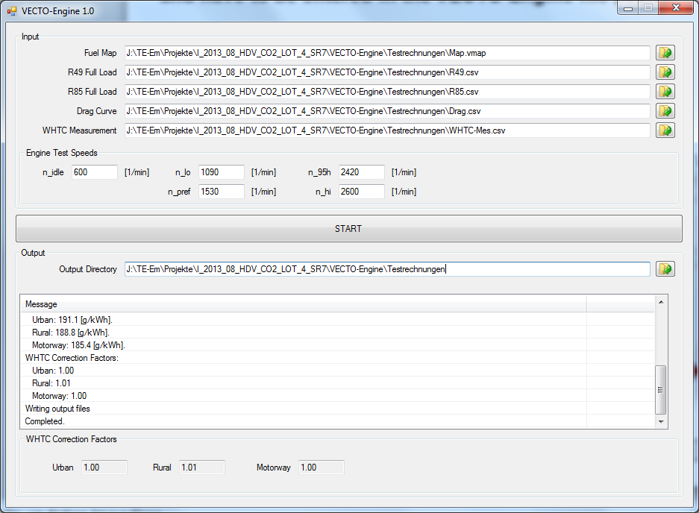
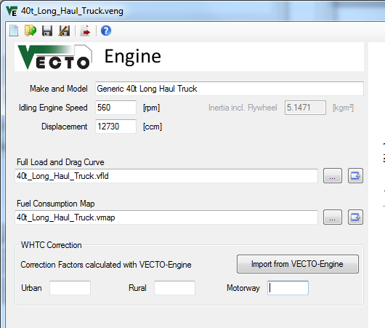
Removed WHTC Correction Factor Calculation
The WHTC Correction Factors are now calculated in an external tool, VECTO-Engine and have to be loaded in the VECTO Engine file (.veng) via an XML transfer file (or entered manually)
VECTO-Engine (distributed separately)
Engine Editor
XML

Slide 6
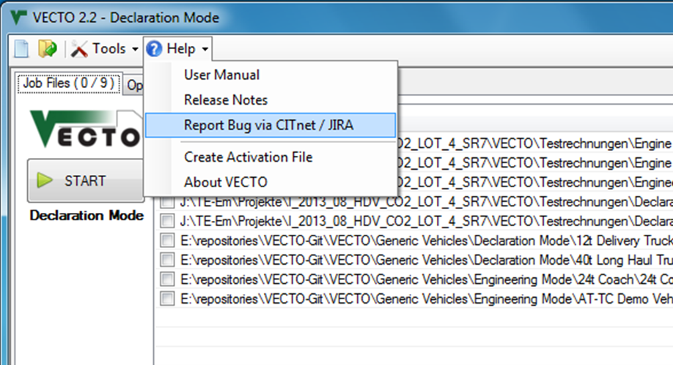
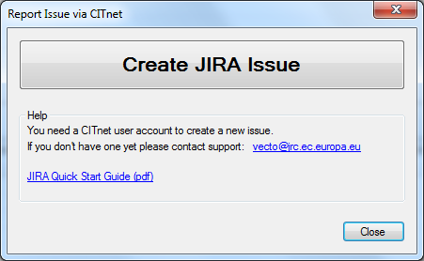
Create JIRA Issue
Use the button in the Help menu to go to JIRA or open a Quick Start Guide.

Slide 7
Full Changelog since V2.1.4
VECTO 2.2
Bugfix: Error in Declaration Mode Pneumatic System aux power calculation ([kW] were interpreted as [W])
Bugfix: Error in Declaration Mode Electric System aux power calculation
Moved gear-specific Full Load Curves to Gearbox File
Combined Drag Coefficient * Cross Sectional Area in one input parameter
Updated .vgbx file format (Added gear-specific Full Load Curves)
Updated .veng file format (Removed gear-specific Full Load Curves)
Updated .vveh file format (Combined Drag Coefficient * Cross Sectional Area in one parameter)
Updated Generic Vehicles (new file formats)
Removed WHTC Correction Factor Calculation. Now in external tool, VECTO-Engine.
Test Options are now only available in Engineering Mode
Gearbox Editor now shows generic and user-defined shift polygons (if available)
Various small updates in GUI
Added 'Create JIRA Issue' dialog
For full changelog see VECTO Main Form > Help > User Manual or CITnet.

Slide 8
Full Changelog since V2.1
VECTO 2.1.4
Bugfixes in start gear and (A)MT shift model
Updated Coach .vcdv file for higher speeds to avoid extrapolation
Renamed output "FC" to "FC-Map" for better clarification
Same header for g/h and g/km output
Reduced minimum turbine speed for 1C-to-2C AT up-shift condition from 900 to 700rpm.
Updated cross wind correction parameters to current White Book values
VECTO 2.1.3
PwheelPos output in VSUM file.
Implemented new Cd*A(v) method
Bugfix in TC model
Bugfix: Unit error in Cd(v) methods caused incorrect Delta-Cd value being used
VECTO 2.1.2
Improved TC iteration for higher precision
Extended possible TC speed ratio
VECTO 2.1.1
Bugfix: Incorrect torque calculation in AT/TC model caused early up-shifts
Updated C-to-C shift strategy with acc_min rule (see V2.1)
For full changelog see VECTO Main Form > Help > User Manual or CITnet.

Slide 9
VECTO 2.1 21.04.2015
Release Notes

Slide 10
VECTO 2.1
New AT/TC options:
Limit engine rpm in torque converter operation acc. ≥ acc_{min}
Shift up (C-to-L, L-to-L) if acc. ≥ acc_{min} and next-gear-rpm > threshold
rpm limit [1/min] and acc_{min} [m/s²] parameters are currently user-defined
C-to-C up-shift condition based on N80h engine speed (instead of N95h)
P_{wheel} input (SiCo test mode)
P_{wheel} as cycle input
Overwrites power calculation
VECTO only calculates power train losses, engine torque/rpm and fuel consumption

Slide 11
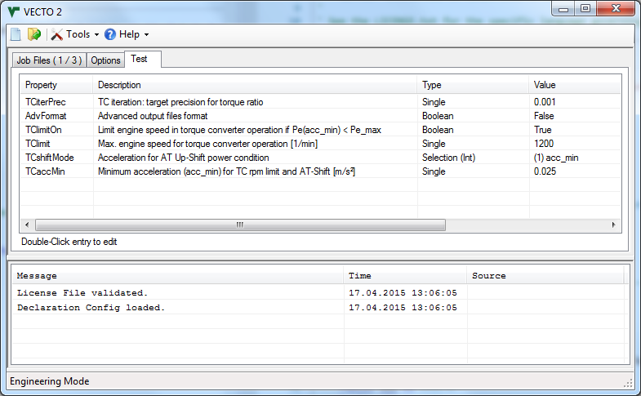
AT/TC model update
"Test" tab in main form includes new parameters.
Note: This is a temporary solution until model and parameters are verified!

Slide 12
AT/TC model update
New AT/TC paramters:
TClimitOn (True / False)
Enables engine rpm limit in TC operation
TClimit [1/min]
engine rpm limit (if TClimitOn = True)
TCshiftMode (0/1)
Mode 0: acc_target - Shift up if power demand with target acc. < power-max (pre-V2.1 default)
Mode 1: acc_min - Shift up if power demand with min. acc. < power-max
TCaccMin [m/s²]
Minimum acceleration for ShiftMode 1 and TClimit
Note: This is a temporary solution until model and parameters are verified!

Slide 13
AT/TC model update
Change parameters in Test tab by double-click
Parameters are saved on application level (..\config\DEVconfig.txt)
Note: This is a temporary solution until model and parameters are verified!

Slide 14
P_{wheel} Input (SiCo Mode)
P_{wheel} can be defined in driving cycle to overwrite power calculation
Requires Gear and Engine Speed input
Cycle identifier: <Pwheel>
Only time-based cycles are supported
Distance Correction must be disabled (Options tab in main form)
Example driving cycle

Slide 15
P_{wheel} Input (SiCo Mode)
Constant point calculation
Define (at least) two identical times steps
(Optional) Add additional auxiliary power consumption with <Padd>
It is suggested to define one cycle per constant point and use Batch Mode
Example: Calculation of two constant points tests
Cycle 1.vdri
.vsum results
Cycle 2.vdri

Slide 16
Full Changelog V2.1
Limit engine rpm in torque converter operation acc. > acc_min
Shift up (C-to-L, L-to-L) if acc. > acc_min and next-gear-rpm > threshold
C-to-C up-shift condition based on N80h engine speed (instead of N95h)
Pwheel-Input (SiCo Mode)
FC [g/h] is always saved in output (in addition to [g/km]), not only in Engine Only mode
GUI: Corrected air density unit in GUI
Bugfix: Format error in .vmod header

